Slide 1
TikTok.com
By Brandon Dempsey

Slide 2
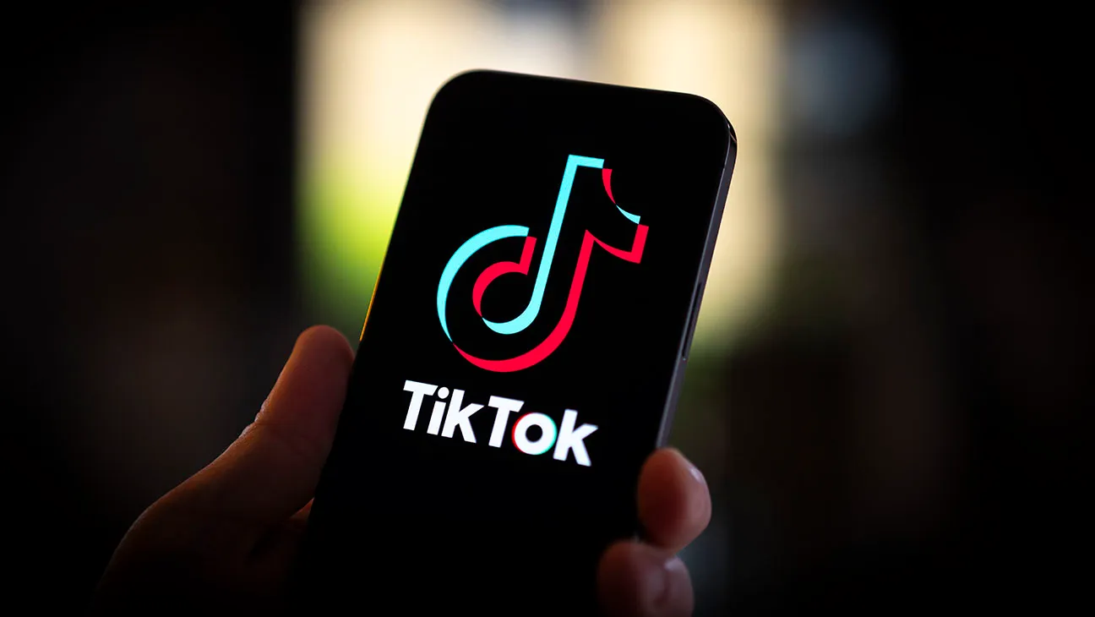
What is TikTok?
TikTok is a social media website
Primarily for sharing short-form videos
Live streaming

Slide 3
History
Owned by ByteDance
An expansion of Douyin
Launched as TikTok internationally in September 2017
Bytedance merged with Musical.ly in November 2017

Slide 4
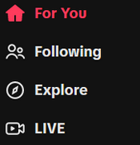
Algorithm
TikTok’s Algorithm is based on
Accounts you follow
Videos you’ve liked, favorited, or shared
Videos you’ve marked as “Not Interested”
Watching a video until the end

Slide 5
Monetization
Advertisements
In-App Coins
Viral Marketing

Slide 6
Website Ranks
Global rank - #14
Country Rank - #23
Category Rank - #7
Total Visits Last Month – 2.2 billion

